Slide 1


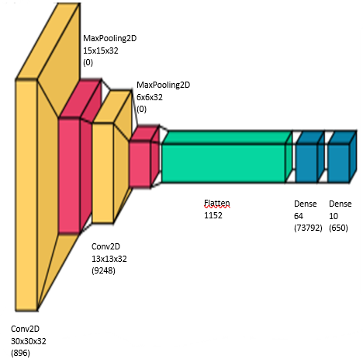
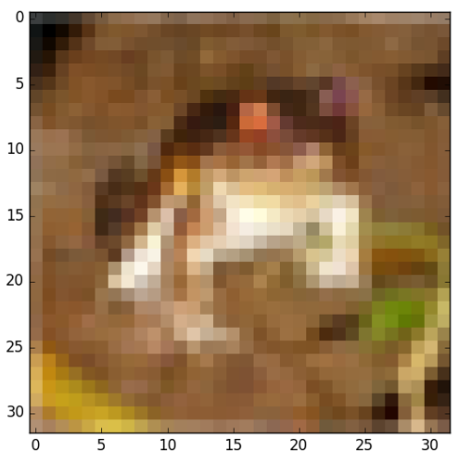
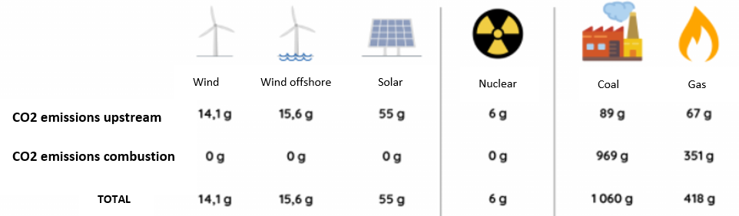
Green AI: the digital, economic and ecologic sobriety
Aïcha BACCAR¹, Waleed MOUHALI¹, Caroline GANS COMBE², Jae Yun JUN KIM¹ 1 ECE Paris, 2 INSEEC Grande Ecole
Context
State of the art
The ecological and digital transitions represent two major challenges for our time. However, increasing the capacity required to improve algorithms for processing operations may go against the environmental preservation that is essential to the ecological transition. Many analyses and studies show that Artificial Intelligence (AI) can have a negative impact on the environment . In 2018, researchers proved that the computation used in various AI training models doubled every 3.4 months since 2012, representing a 300,000% increase. MIT researchers have estimated the carbon footprint of four AI models (GPT-2, BERT, ELMo, Transformer) and training just one model could generate around 282 tones of CO2 equivalent (5x more than an American car over its entire life cycle). Paradoxically, it was also shown that artificial intelligence could be a key tool in the fight against climate change, making artificial intelligence a necessity for the future.
In this work, we will demonstrate that it is possible to implement an approach and a method that help achieve "digital" "economic" and "ecologic" sobriety.
One of the most cited literature has given 4 recommendations which are “authors should report training time and sensitivity to hyperparameters”, “academic researchers need equitable access to computation resources”, and “researchers should prioritize computationally efficient hardware and algorithms”[1]
Another study established the model of the 4 Ms [2], which are, according to the authors, some of the best practices to reduce the energy consumption and the carbon emissions: “Model: selecting efficient ML model architectures”, “Machine: Using processors optimized for ML training”, “Mechanization: Computing in the cloud” and “Map: pick the location with the cleanest energy ”
A framework for carbon aware data centers have been designed involving energy investments, energy storage, and computation shifting [3]
Making judicious hardware-software choices such as “Platform-Level Caching”, “GPU acceleration” and “Algorithmic optimization” could greatly optimize different areas of LMs [4]
The current studies have been mainly focusing on reducing the energy waste and carbon emissions caused by artificial intelligence, but the economic aspect has not been tackled as much. That is why, we set ourselves the task to find a way to achieve digital sobriety but also economic and ecologic sobrieties.
Research question
Objectives
Can we reduce the cost and environmental impact of artificial intelligence while maintaining the same performance and results and by reducing the data resources in order to achieve a digital, economic and ecologic sobriety and therefore a green AI?
Conduct an extensive literature review on all the current solutions for Green AI
Go beyond the above literature studies by a) proposing a "path" for AI to be green and b) implementing this "path" using Python for some use cases.
Compare prices (or costs) for green and non-green AI
Methodology
Energy source | Coal | Gas (combined cycle) | Wind | Nuclear | Solar
Price in USD per kWh | 0.108 | 0.06 | 0.038 | 0.168 | 0.036
Training of a CNN model with different size of training set in order to get the accuracy and the energy consumption depending on the training set.
Hardware:
Hp Z240 SFF
Intel ® i7-7700
CPU 3.60GHz
8 Processors
Threads per core Software:
Python
TensorFlow
Levelized Cost of Energy [6]
Economic
sobriety
Cost per
energy
source
DATA
Algorithm
Hardware and
Software
resources
Digital
sobriety
Energy
consumption
Ecologic
sobriety
CO2eq per
energy
source
Cifar10 sample
60000 32x32 colour images
10 classes with 6000 images per class.
50000 training images and 10000 test images
Accuracy
CNN architecture
Hardware and Software specifications
Life Cycle Analysis of energies[5]
Results
Digital sobriety
Economic sobriety
Ecologic sobriety
Size of the training set | 4992 | 12480 | 24960 | 37440 | 44992 | 49984
Accuracy | 0.53771999 | 0.591936361 | 0.63569999 | 0.662430006 | 0.669888887 | 0.6785909
Energy usage | 1,69E-02 | 4,11E-02 | 8,08E-02 | 1,21E-01 | 1,39E-01 | 1,60E-01
Size of the training set | 37440 | 44992 | 49984
Charbon | 0.013068 | 0.015012 | 0.01728
Gas ( cycle combiné) | 0.00726 | 0.00834 | 0.0096
Eolien | 0.004598 | 0.005282 | 0.00608
Nucléaire | 0.020328 | 0.023352 | 0.02688
Solaire | 0.004356 | 0.005004 | 0.00576
 | Difference of cost between algorithm using 37440 and 49984 images in US dollars | Difference of cost between algorithm using 37440 and 49984 images in US dollars | Difference of price between algorithm using 37440 and 49984 images and between sources of energy in US dollars (with solar energy as reference)
Coal | 0.004212 | 32% | 184%
Gas ( combined cycle) | 0.00234 | 32% | 58%
Wind | 0.001482 | 32% | 0%
Nuclear | 0.006552 | 32% | 342%
Solar | 0.001404 | 32% | -5%
 | Difference of CO2eq emissions between algorithm using 37440 and 49984 images in g/kWh | Difference of CO2eq emissions between algorithm using 37440 and 49984 images in g/kWh | Difference of CO2eq emissions between algorithm using 37440 and 49984 images in g/kWh (with wind energy as reference)
Coal | 4.13E+01 | 32% | 7025%
Gas ( combined cycle) | 1.63E+01 | 32% | 2715%
Wind | 5.79E-01 | 32% | 0%
Nuclear | 2.34E-01 | 32% | -60%
Solar | 1.32E+00 | 32% | 128%
Size of the training set | 37440 | 44992 | 49984
Coal | 128.018 | 147.062 | 169.28
Gas ( combined cycle) | 50.578 | 58.102 | 66.88
Wind | 1.79685 | 2.06415 | 2.376
Nuclear | 0.726 | 0.834 | 0.96
Solar | 4.0898 | 4.6982 | 5.408
Discussion:
Formation of a plateau for the accuracy between the training sets of 37440 and 49984.
The energy consumption continues to increase even during the plateau.
Discussion:
Reducing the training set size to 37440 images instead of 49984 could help save up to 32% of the general cost of the algorithm.
Choosing certain source of energies, can reduce the cost up to 342% if the wind energy is used instead of the nuclear energy or up to 184% instead of coal.
Discussion:
Reducing the training set size to 37440 images instead of 49984 could help save up to 32% of the emissions of CO2eq.
Choosing certain source of energies, we can reduce the emissions up to 7025% if the wind energy is used to power the algorithm instead of the coal, and up to 2715% instead of gas.
Here we can observe that the nuclear energy is the one which emits the least between all the energy, but radioactive waste is dangerous.
Conclusion and future works
References & sources
After running the same algorithm multiple times with different size of training sets, we were able to conclude that it is possible to reduce the cost as well as the energy consumption of an algorithm without altering the performances of the algorithm. By reducing the size of the training set from 49984 to 37440 we should be able to reduce the cost and the energy consumption by 32%. Moreover, by choosing some energy instead of others we can also reduce significantly the cost of the algorithm as well as its emission.
Now that our hypothesis has been confirmed on a small algorithm, our future work will be to:
- Apply this method on bigger CNN structures such as AlexNet.
- Add the notion of dynamic cost.
- Expand the environmental impact to more than CO2eq emissions.
[1] Strubell, Emma, Ananya Ganesh, and Andrew McCallum. "Energy and policy considerations for deep learning in NLP." arXiv preprint arXiv:1906.02243 (2019).
[2] Patterson, David, et al. "The carbon footprint of machine learning training will plateau, then shrink." Computer 55.7 (2022): 18-28.
[3] Acun, Bilge, et al. "A Holistic Approach for Designing Carbon Aware Datacenters." arXiv preprint arXiv:2201.10036 (2022).
[4] Wu, Carole-Jean, et al. "Sustainable ai: Environmental implications, challenges and opportunities." Proceedings of Machine Learning and Systems 4 (2022): 795-813.
[5] ADEME 2020 https://www.ademe.fr/
[6] LAZARD 2021 https://www.lazard.com/

